Slide 1
Use of Git and GitHub
Git and GitHub are useful tool for collaboration and distribution of the codes
They allows Better version and efficient collaboration
Most of the Linux system have installed git
We all have used the command “Git clone” to download other repositories before
https://github.com/lammps/lammps.git

Slide 2

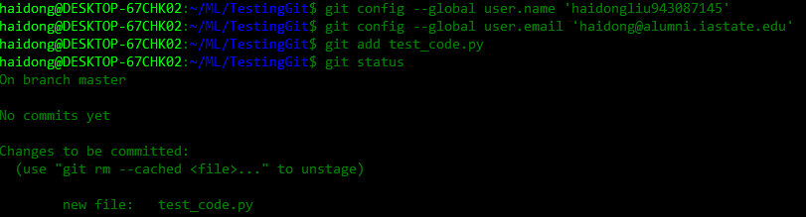
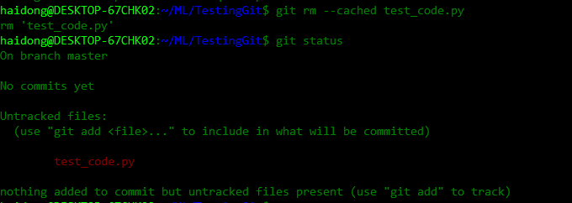
Working on local repository
git init
-- initialize a git repository
git add <file>
git rm <file>
git status
git commit
-- commit the change made to the repository

Slide 3
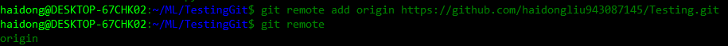
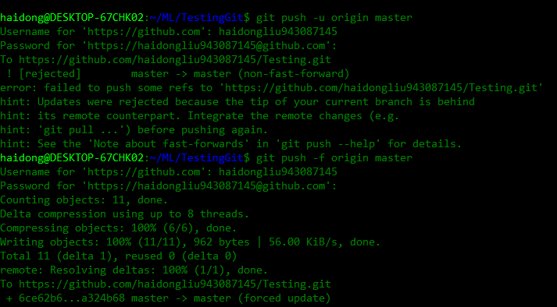
On remote repository
Git remote add
--Set up the link between local and remote repository
Git push
--push the master branch onto the remote repository
Git pull
--pull everything from the remote repository and update local repository

Slide 4

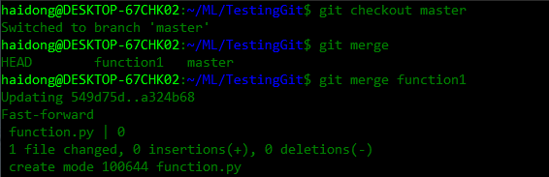
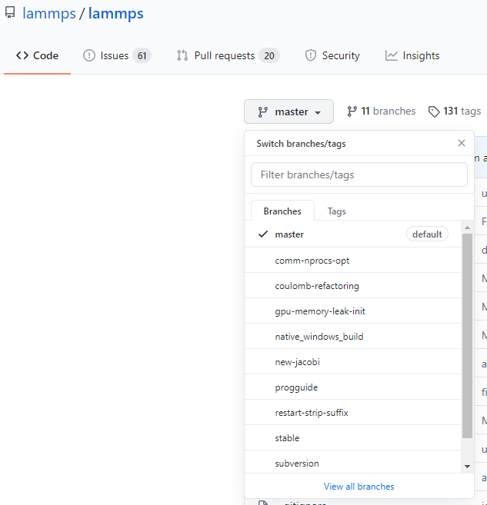
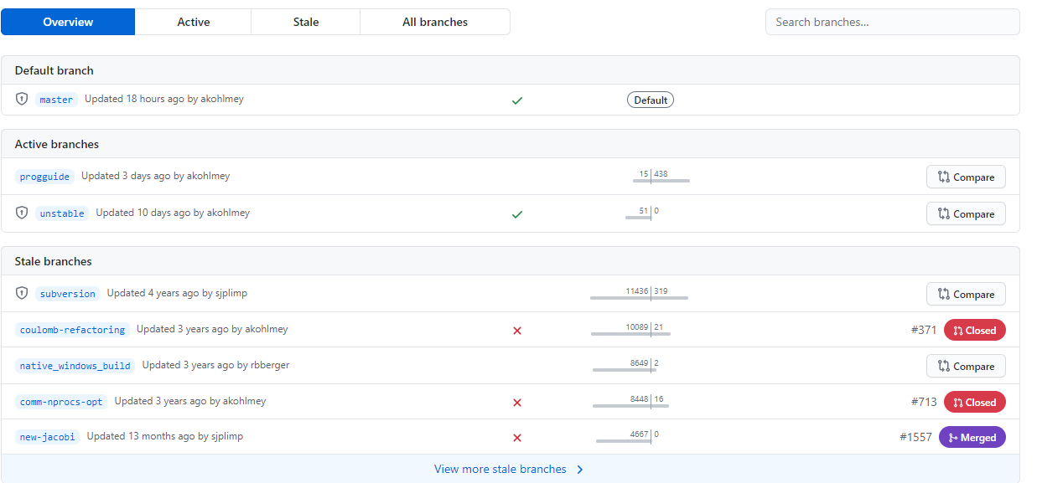
Working on different branch
Git branch
Git checkout
-- switch to a new branch to work separately from the master branch
Git merge “different branch”
--merge the branch onto master

